Slide 1
Analysis of Singapore’s Population Health Programme (PHP)
Presented By: Group 15
Notes:
Good afternoon executives. I’m Zhe Wei and today, my team and I will be presenting an analysis of Singapore’s Population Health Programme to help you better understand the population health and how you can make better decisions moving forward.

Slide 2
Our Analytical Framework
Problem Solving
04
Prescriptive Analytics
Insights
03
Diagnostic Analytics
Data Visualisations
02
Descriptive Analytics
Filtering and Handling
01
Data Cleaning
Notes:
Firstly, our team undertook this analytical framework in analysing the given dataset. We utilised a bottom up approach, and analysed specific characteristics of the data before moving on to macrotrends. To do that, we must first carry out data cleaning, where we fixed or removed incorrectly formatted, or incomplete data. For instance, when analysing health risk, we filtered out NA values and only considered Good and Poor controls when analysing ControlGroup. Furthermore during some of our analysis, we grouped values together to gain insight on the bigger picture. Next, we moved on to descriptive analytics where we generated visualisations like charts and graphs to better understand the data. Thereafter, we diagnosed the data and formulated insights that will be critical for our prescriptive analytics in the last stage.

Slide 3
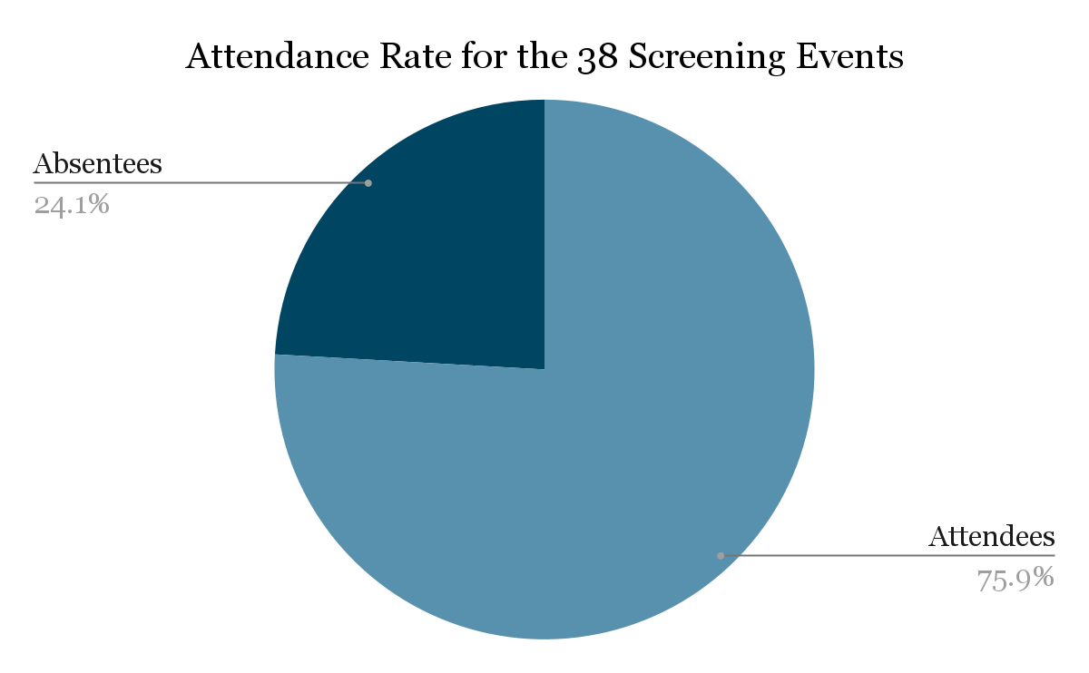
We analysed the dataset of 5191 residents who turned up for the health screenings
Almost 1 out of 4 residents did not attend the health screening.
Notes:
Out of the 6840 residents targeted for outreach and screening from Sembawang and Choa Chu Kang, 75.9% of residents turned up for the screening events and our team analysed the complete dataset of these attendees. As you can note, there is still a significant 24% of residents who did not turn up, and towards the end of our analysis, we will be discussing solutions to increase the turnout rate for the health screenings based on the insights we’ve discovered.

Slide 4
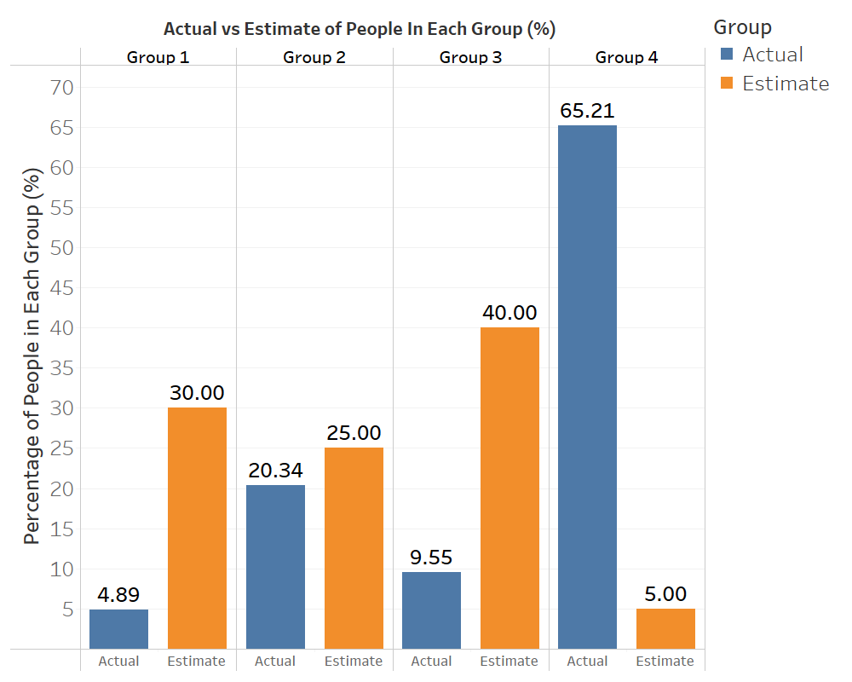
Huge deviation between estimates and actual figures of the population’s health profile
65% of residents fall in Group 4 - classified as unhealthy people with negative habits, as compared to 5%.
74% of residents are unhealthy.
Notes:
Moving on, a key finding in our analysis is that the actual figures of the population’s health profile deviate significantly from the hospital’s initial estimates. The orange charts represent the estimated figures and in actuality, the actual figures represented in blue have stark differences. Most notably, for residents in Group 4, who are classified as unhealthy individuals with negative habits the difference is 13x higher. With that, we also observe that 74%, around ¾ of participants are unhealthy.

Slide 5
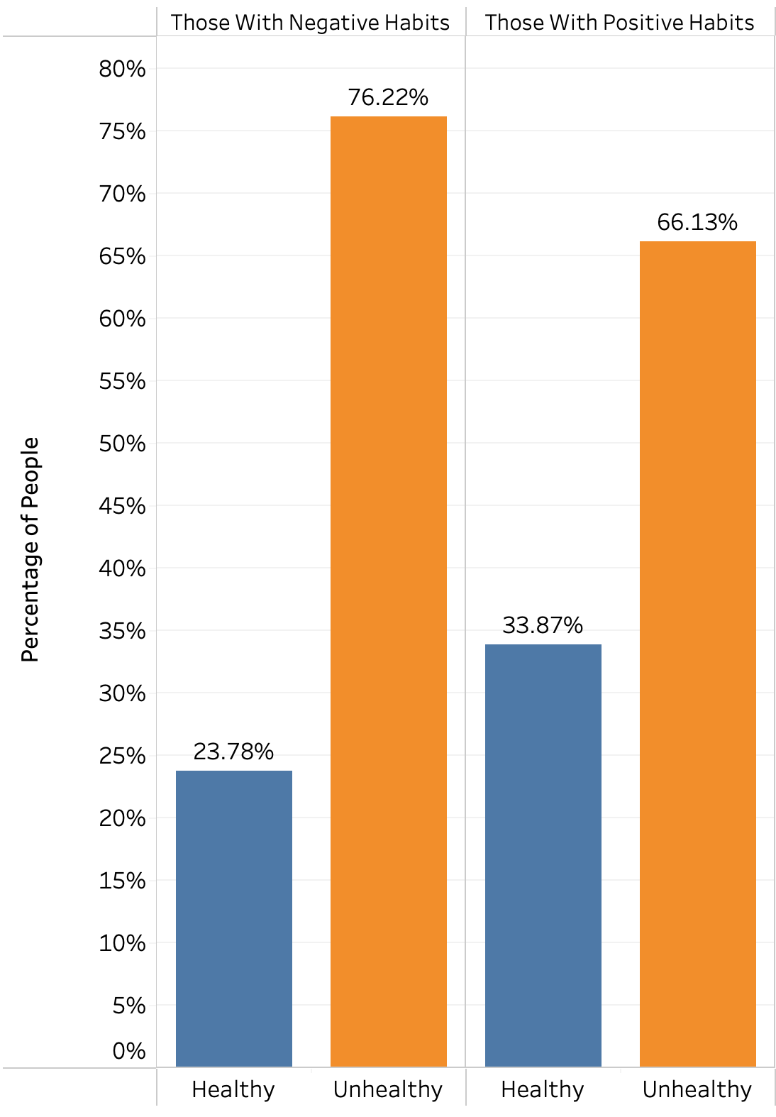
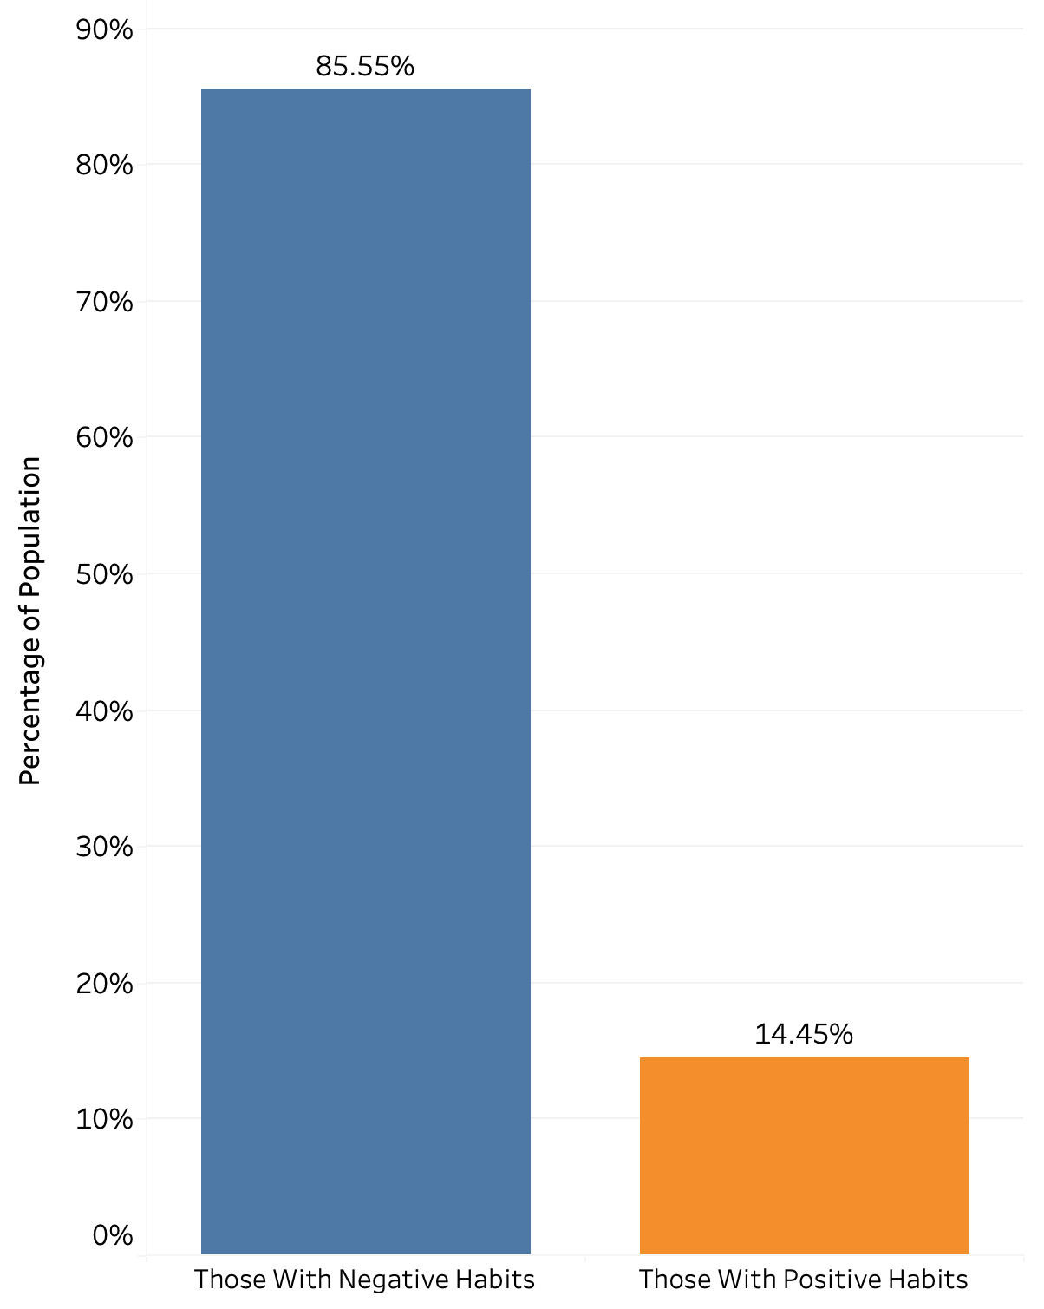
There is a higher proportion of Singaporeans with negative habits than positive ones
85.55% of residents have negative habits.
Higher proportion of residents with negative habits are unhealthy.
Notes:
Moreover, there is also a higher proportion of residents with negative habits than positive ones, as you can see, 85% of residents have negative habits. There is also a clear trend as you can observe from the chart on the right that residents with negative habits tend to be more unhealthy. Why is this so?

Slide 6
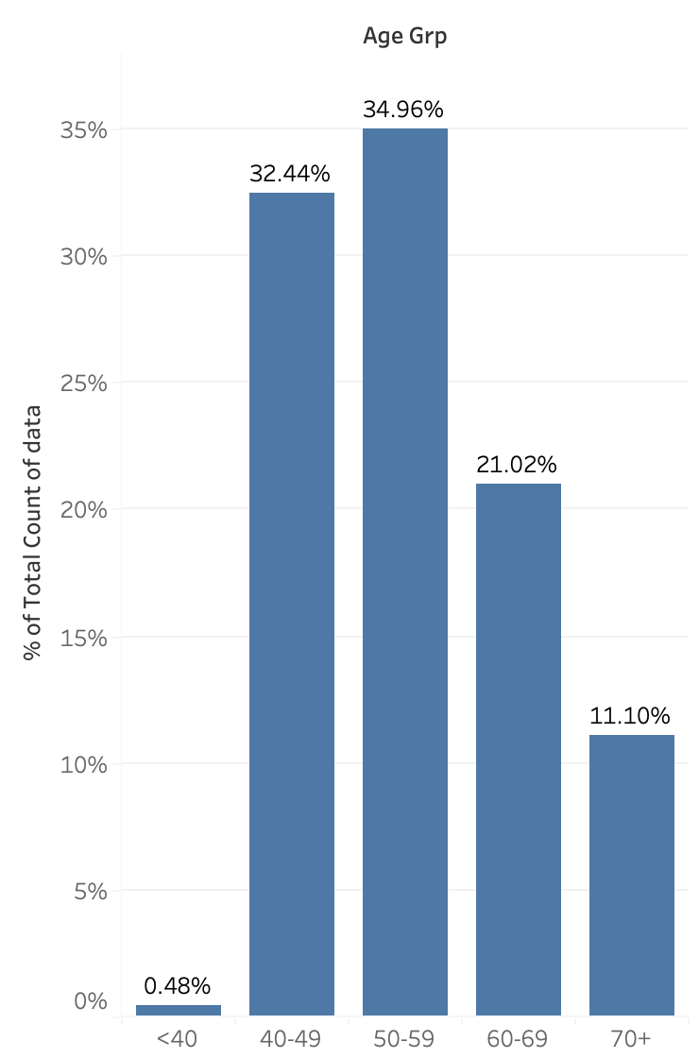
Preliminary analysis of our dataset suggests potential reasons for the huge deviation - Ageing Population
67% of population are above 50, and older age is linked to poorer health and a harder upkeep of healthy habits.
Notes:
Our preliminary analysis of the dataset actually suggests potential reasons for the huge deviation and our general observations thus far. Firstly, 67.08% of the residents are above the age of 50, and older age is linked to poorer health and a harder upkeep of healthy habits. Similarly, 64% of the population are less educated, having received either no formal education or only up till secondary education. 38% of them also work in blue-collar jobs and these observations imply that residents could have a lower awareness of disease prevention habits or the benefits of having good lifestyle habits.

Slide 7
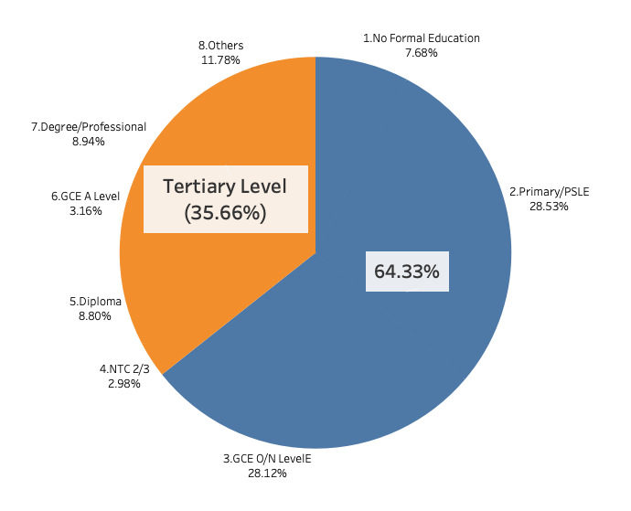
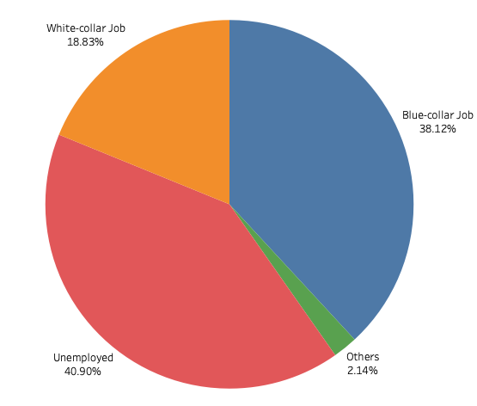
Preliminary analysis of our dataset suggests potential reasons for the huge deviation - Education and Job Type
64% of population are less educated and 38% work in blue-collar jobs, so they are likely to have lower awareness of the importance of their habits.
*Less educated - Uneducated or up till secondary education

Slide 8




Relationships between lifestyle habits and health
Whether the resident smokes
Number of servings of fruits/vegetables
Smoking
Diet
Lifestyle Habits
Amount of exercise per week
Quality of stress management
Exercise
Stress
Notes:
Next, I will now hand over the time to Jacky to run through the relationship between lifestyle habits such as smoking, resident’s diet, their exercise frequency and stress management, and their effects on the health of residents. Jacky please.

Slide 9
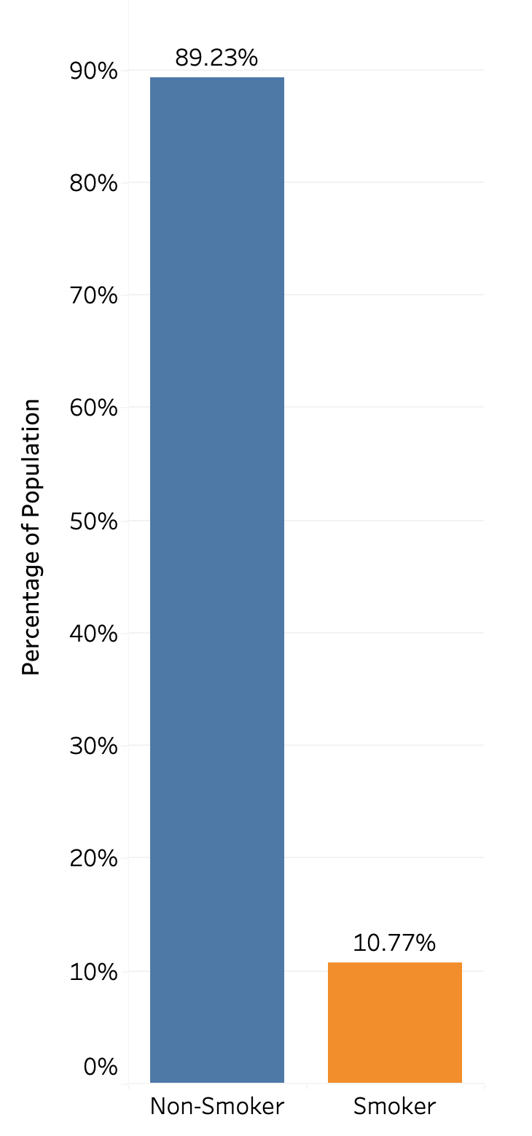
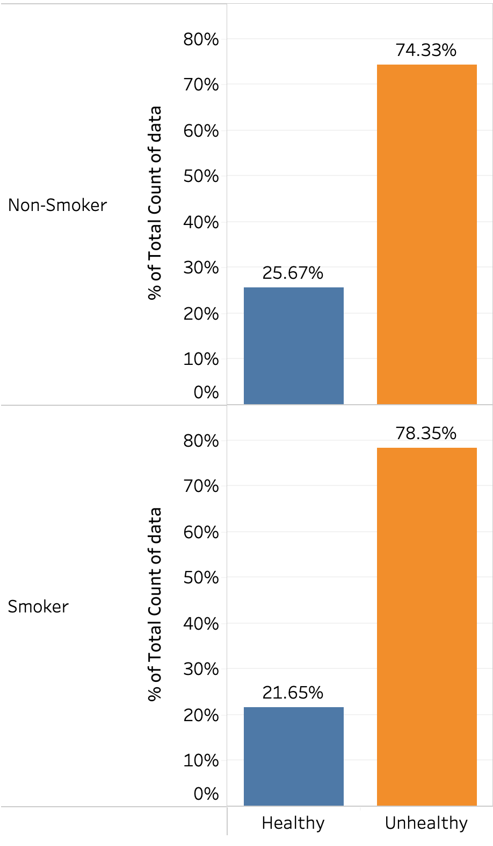
Small proportion of residents are smokers and smoking does not have a significant impact on health
Slight increase of 4% for residents who are smoke that are unhealthy.
Only 10% of residents are smokers.
Notes:
Thank you zhe wei, i now bring your attention to our analysis, where we compare the effects of specific habits on resident’s health, here we can see that majority of residents do not smoke, and smoking only slightly increases the likelihood of the resident to be unhealthy, as such we will not be including targeting smokers as part of our strategy, which we will talk about later on

Slide 10
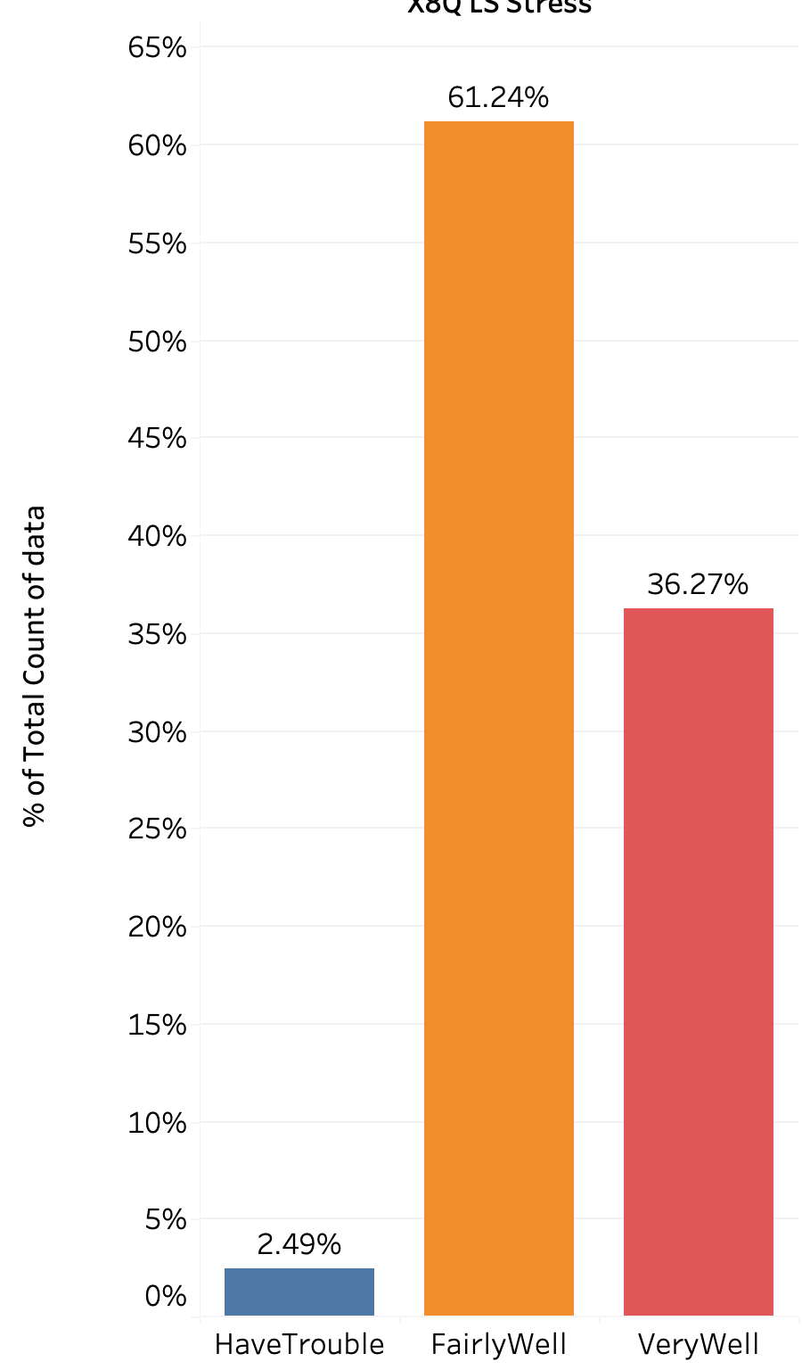
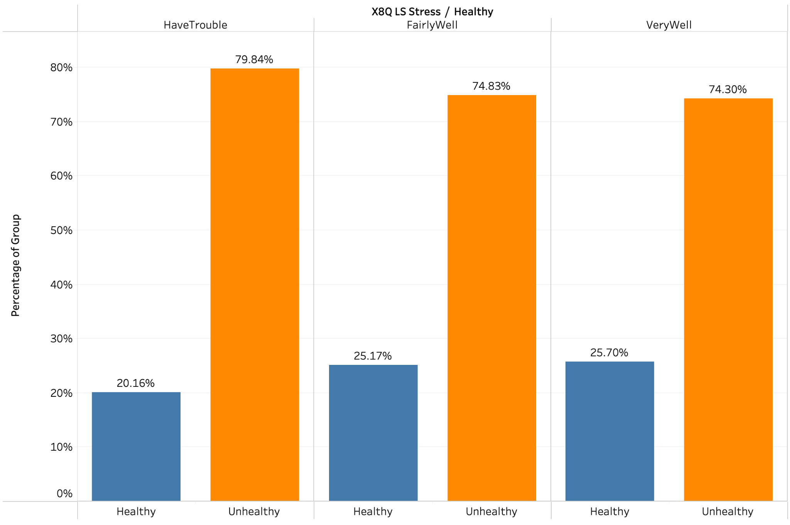
Majority of residents have good ability to cope with stress, thus stress is not a key factor affecting health
The better the resident’s ability to cope with stress, the better their health.
Only 2.5% of residents have trouble coping with stress.
Notes:
Given more than 97% of residents do not have trouble coping with stress, and given the trend that the ability to cope with stress is correlated with health, stress is not a issue for concern, and we will not include stress management as part of our strategy to improve residents health

Slide 11
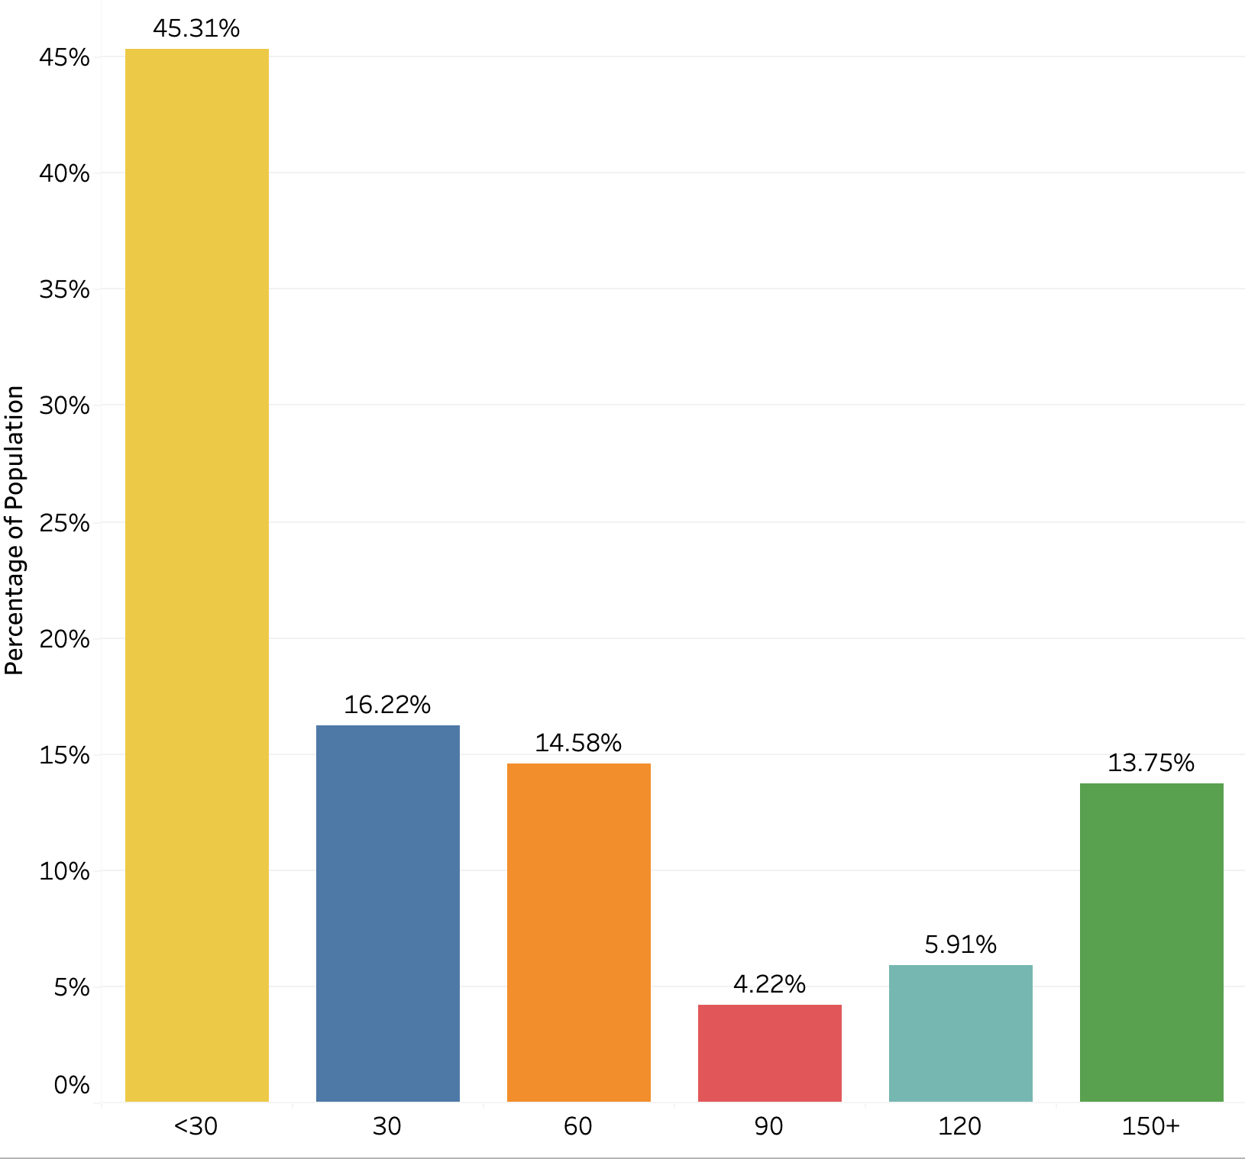

Majority of residents are not getting enough exercise
61% of residents have less than 60 mins of exercise a week
(not enough)
Notes:
Next, moving on to exercise frequency, we can see that 61.5% of residents exercise less than 60 mins a week, which is significantly below the recommended 30 mins of exercise a day given by the health promotion board.

Slide 12
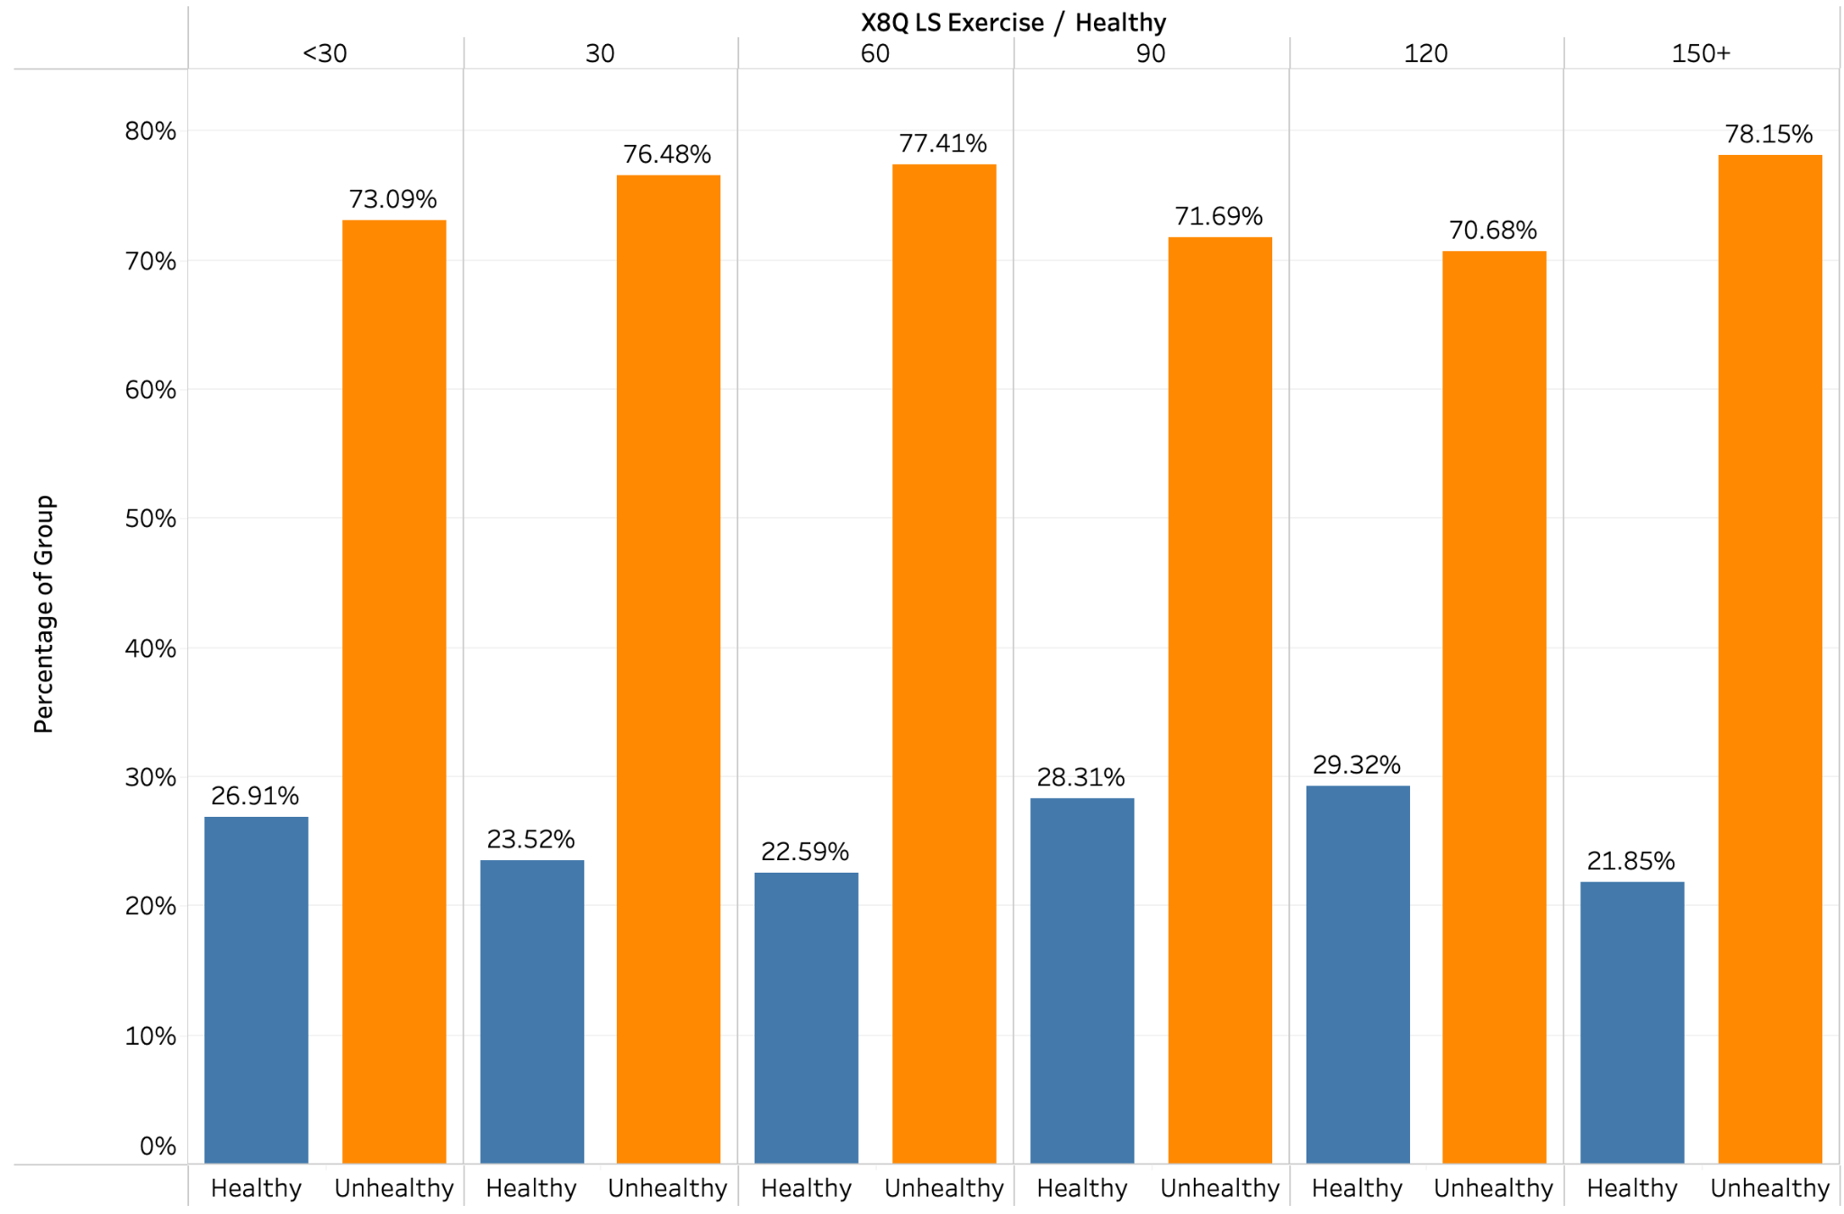
There is no discernible trend between amount of exercise and health
However, we can note that there is a higher proportion of residents who exercise for between 90 and 150 minutes that are healthy.
Notes:
Also, while there is no discernible trend between the amount of exercise and the residents health, we note that there is a higher proportion of residents who exercise between 90 and 150 minutes, that are healthy, thus we will include exercise as part of our strategy to improve residents health

Slide 13
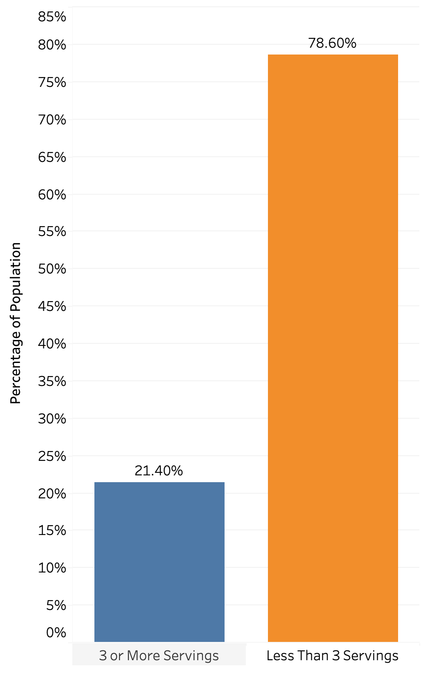
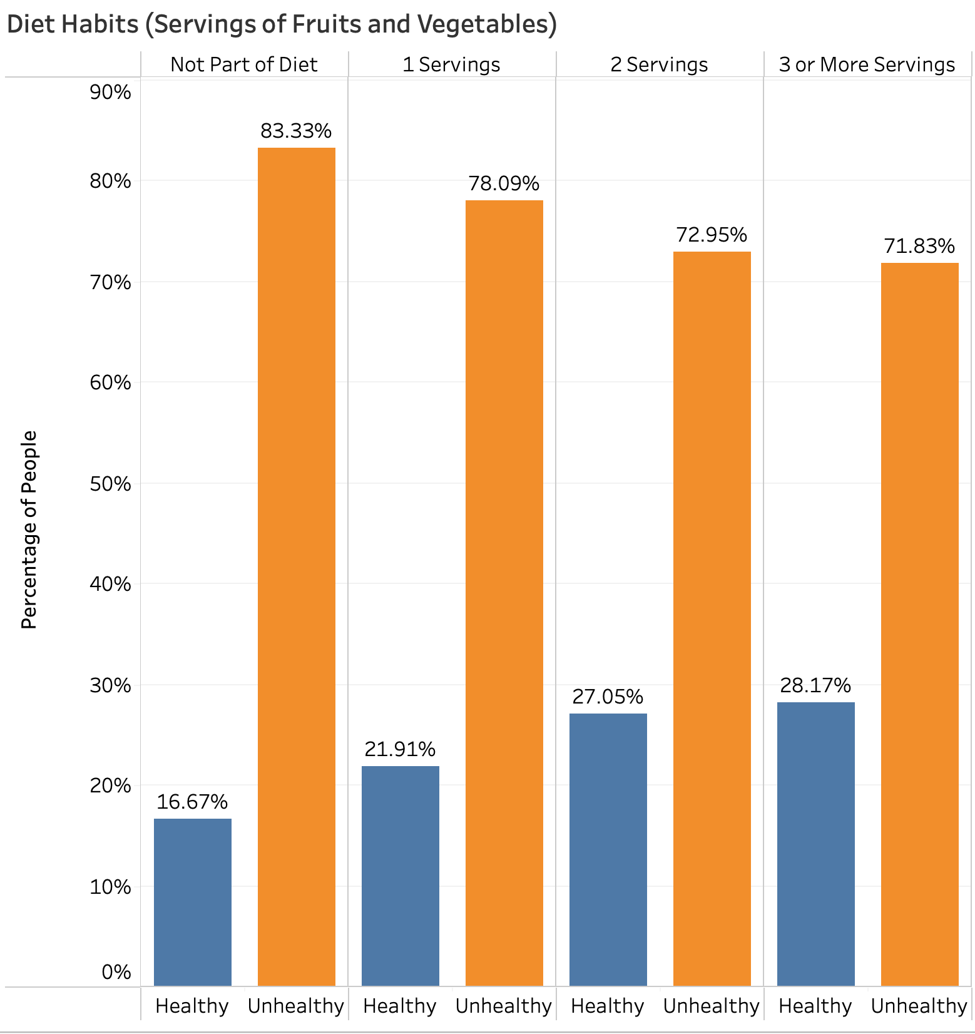
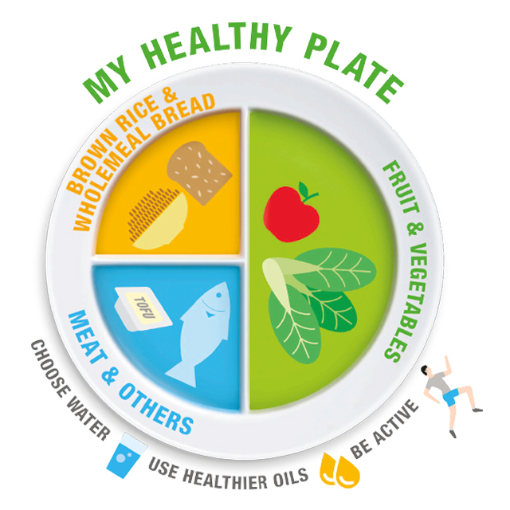
The more servings of fruit consumed, the better the health of residents
78% of residents do not consume enough servings of fruit.
The more servings consumed, the better the health.
Notes:
Through our analysis, we found that diet has the most significant effect on the health of residents, we can see a clear trend that the more servings of vegetables residents eat, the better their health, we also note that 78.6% of residents do not consume enough servings of fruit, and this is the key habit that we will focus on in our solutions.

Slide 14
Singaporeans are more unhealthy than predicted.
Huge deviation from hospitals’ estimates.
Most residents are classified under Group 4.
74% of residents are classified as unhealthy.
85% of residents have negative habits.
Diet has the most significant correlation with health status.
Notes:
Thus, given the huge deviation from hospitals estimates for residents health and habits, this leads us to the conclusion that Singaporeans are much more unhealthy than we previously thought.

Slide 15
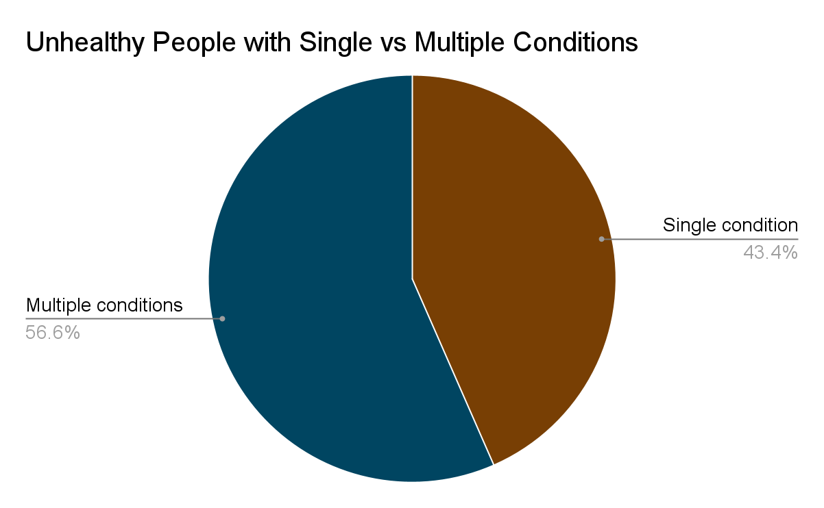
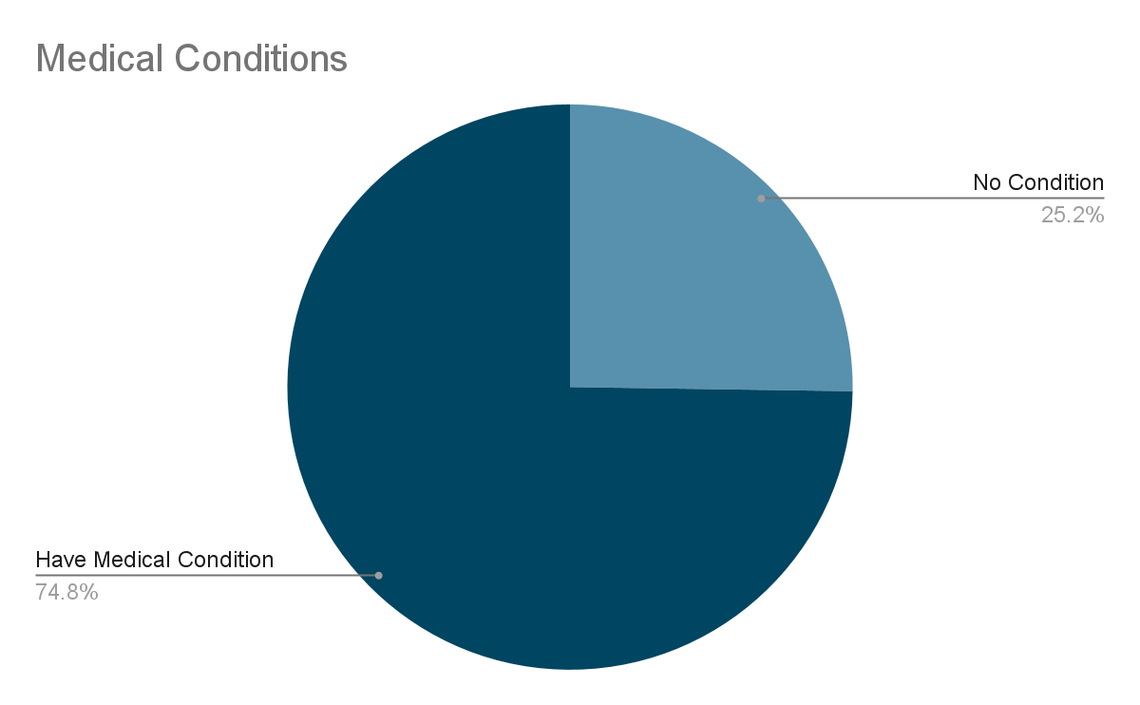
Majority of residents have a medical condition, of whom, majority suffer from multiple conditions
74% of residents have a medical condition.
56% of residents with a medical condition suffer from multiple conditions.
Notes:
Next, we will analyse the relationship between medical condition and health risk. Here you can see that majority of residents suffer from a medical condition, with 75% of residents having a medical condition. This is what we aim to reduce with early detection and control through health screenings moving forward.

Slide 16
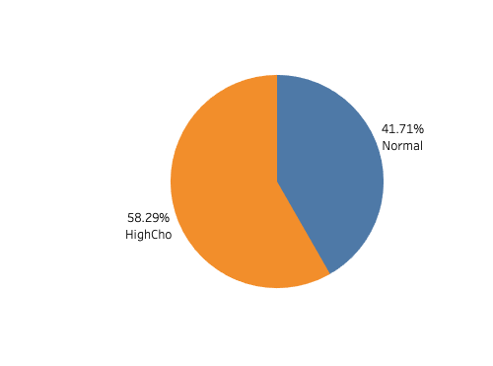
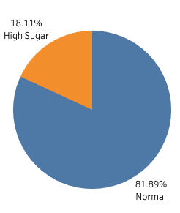
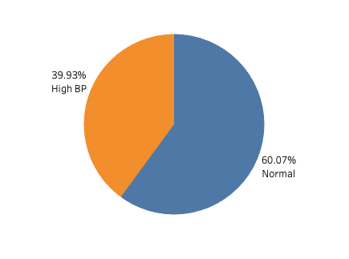
High Cholesterol is the most common condition
Cholesterol
Blood Pressure
High Sugar
58% of residents suffer from high cholesterol, the highest out of any other condition.
Roughly 2 in 5 residents suffer from high blood pressure.
Only 1 in 5 residents suffer from diabetes.
Notes:
Through our analysis, we also found that high cholesterol is the most common condition with more than 1 in 2 residents suffering from high cholesterol as compared to 2 in 5 for high blood pressure and only 1 in 5 for diabetes.

Slide 17
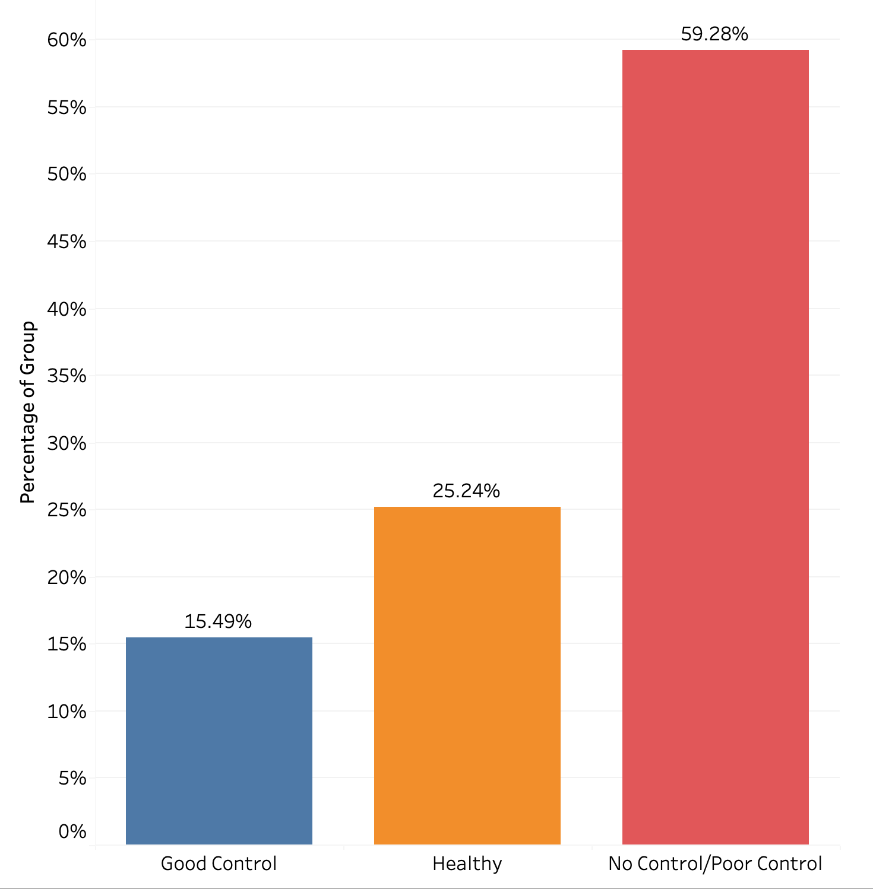
Lack of and poor quality of controls
59% of residents have either poor control or no control for their conditions.
Notes:
We also found that 59% of residents have either poor control or no control for their conditions. Next, I will pass the time over to chong ren to explain why these are worrying figures and tell you more about our analysis on condition control and their impact on resident’s health. Chong ren please.

Slide 18
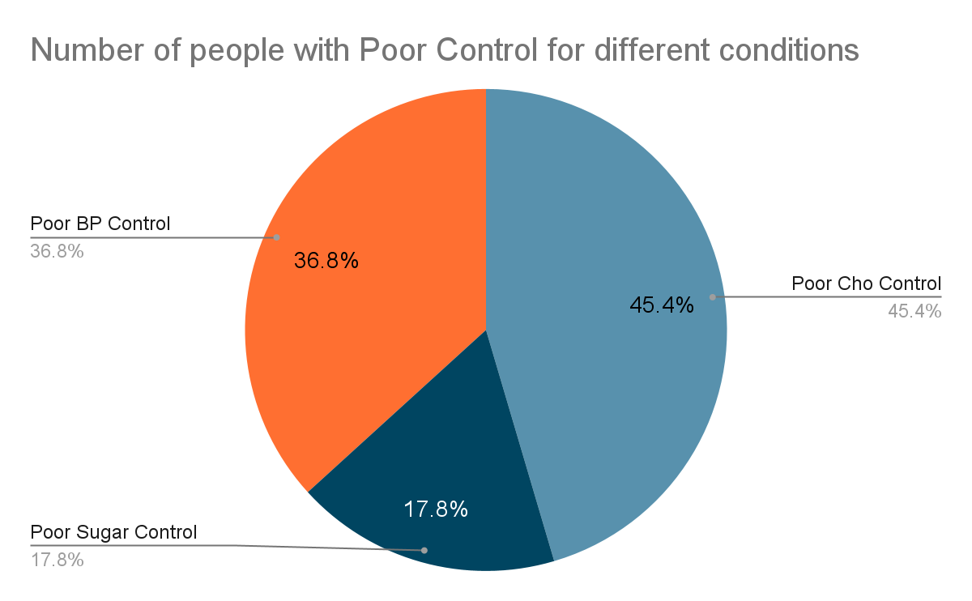
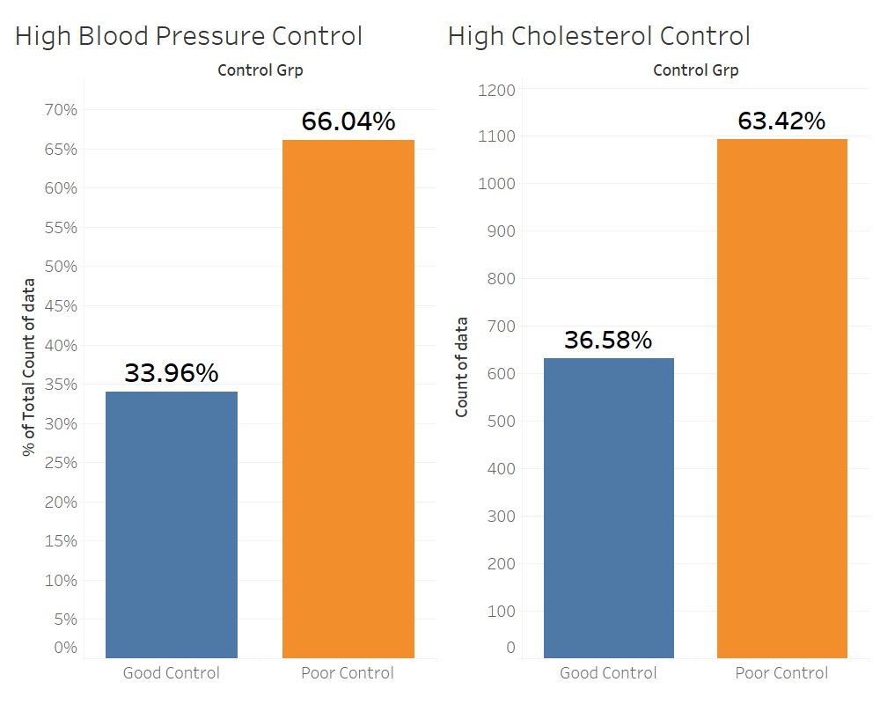
Medical conditions are poorly controlled
High blood pressure and cholesterol are badly controlled.
45% of those with poor control have poor cholesterol control.
Notes:
As can be seen from the graph on the left, of those with poor control over their conditions, the largest number of them has poor cholesterol control with blood pressure as a close second. In fact, of those with controls for high cholesterol, 63.4%, nearly two-thirds have poor control over their condition. Next, we will look into how drastic the health impacts of each condition is.

Slide 19

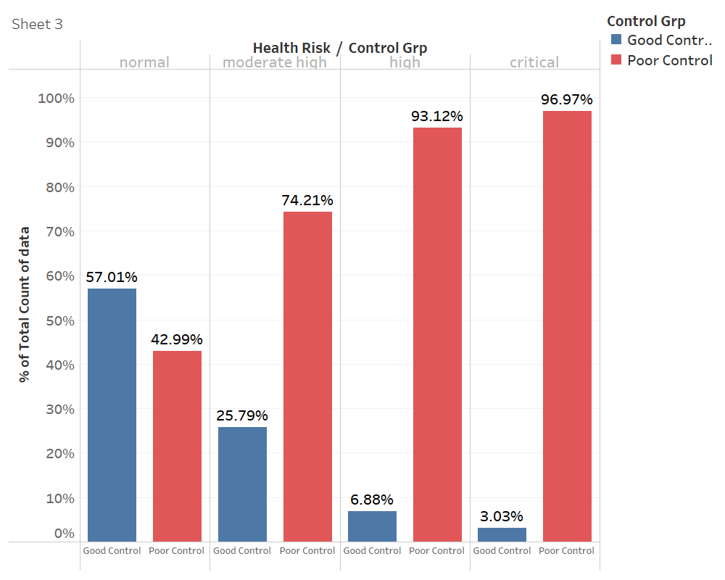
Poor control correlates with significantly higher health risk
Those with poor control are more likely to have higher health risk.
Notes:
Another possible factor that is linked to increased health risk is how well diseases are controlled. Clearly, with good control, your chance of having a higher health risk decreases significantly. Seeing that High blood pressure and cholesterol are the 2 more prevalent conditions and also related to higher health risks, we decided to take a closer look into what specifically high cholesterol and blood pressure leads to.

Slide 20
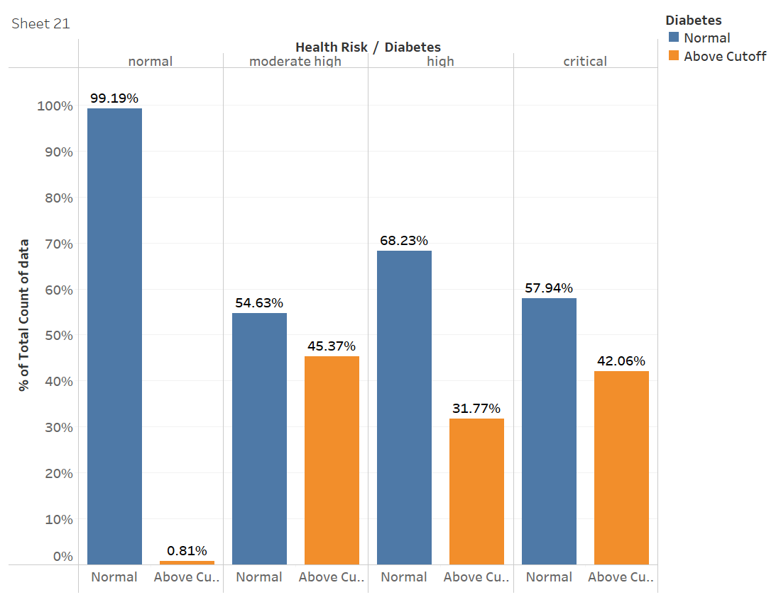
High Sugar does not correlate with increased health risk
There are fewer people with higher health risks with high sugar
Notes:
Firstly, we will look at the impact of high blood sugar. Shown here is a graph depicting the proportions of people with high blood sugar for each health risk group. Of those in the group with normal health risk, almost everyone has a normal blood sugar level. And in the critical health risk group, we see that there are actually more people with a normal blood sugar level than with high blood sugar. Thus we conclude that high blood sugar does not correlate with having a higher health risk

Slide 21
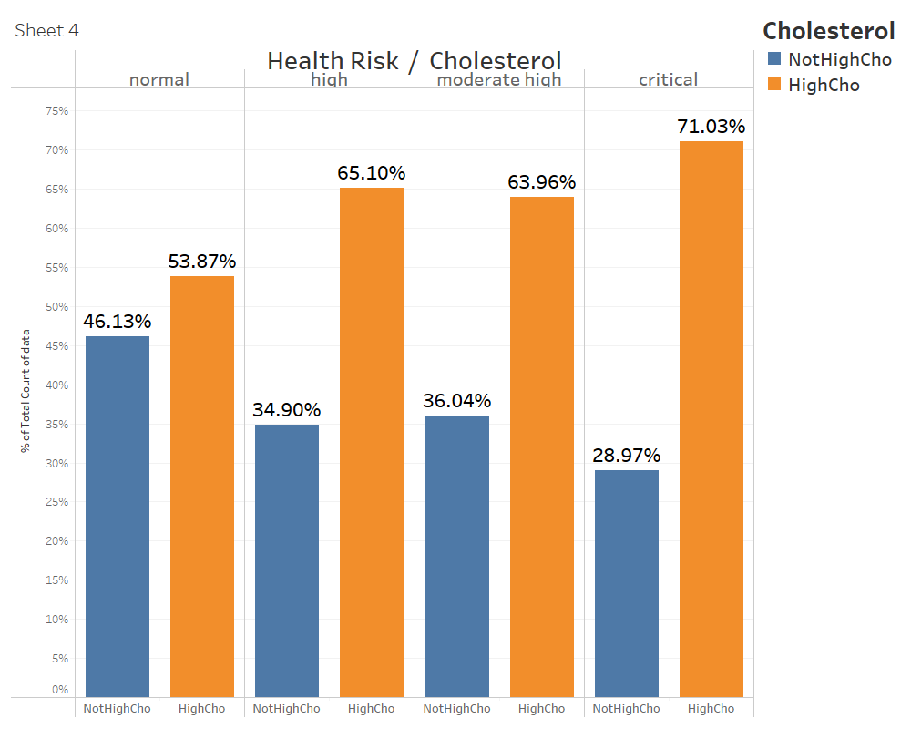
High Cholesterol correlates with significantly higher health risk
High Cholesterol is much more prevalent at higher health risks
Notes:
As shown here, those with high cholesterol are significantly more likely to be at a higher health risk, and this likelihood becomes greater as the health risk increases. With there being almost 2x the number of people with high cholesterol with a heightened health risk. This shows that high cholesterol is directly correlated with an increased health risk

Slide 22
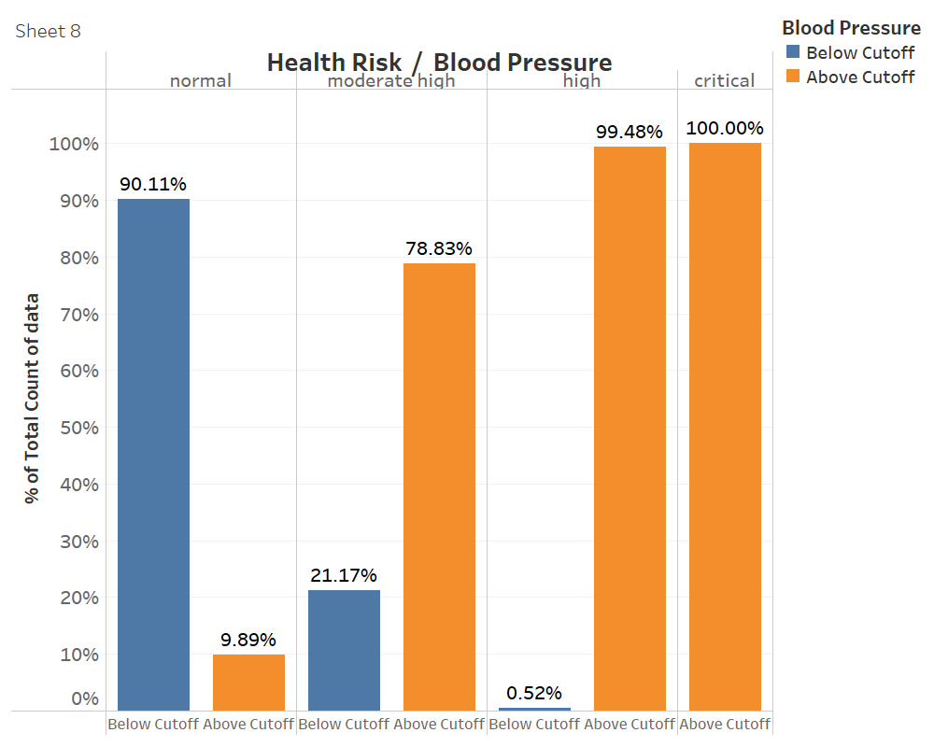
High Blood Pressure correlates with higher health risk
High Blood Pressure is much more prevalent at higher health risks
Notes:
Moving on the blood pressure, this difference is much more drastic as can be seen. Everyone with a critical health risk has high blood pressure and almost everyone with a high health risk has high blood pressure.

Slide 23
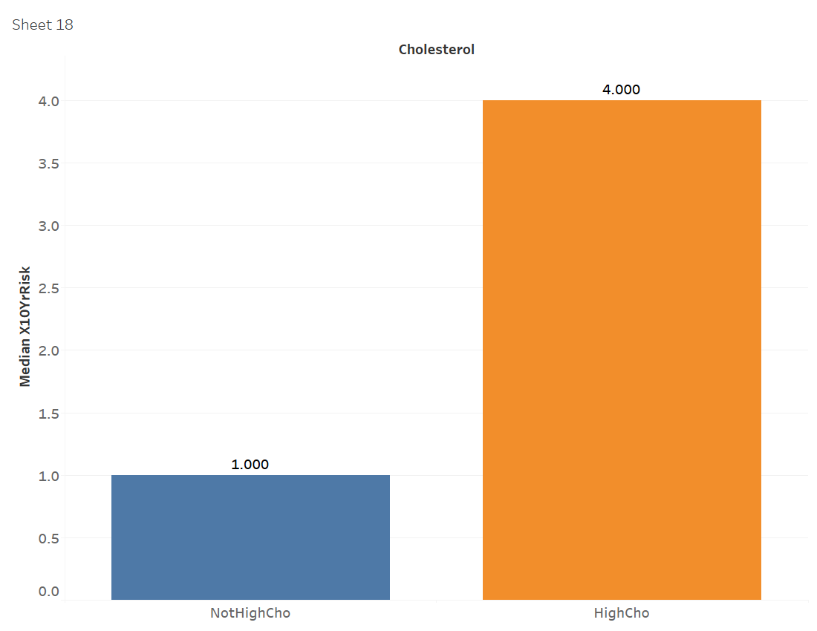
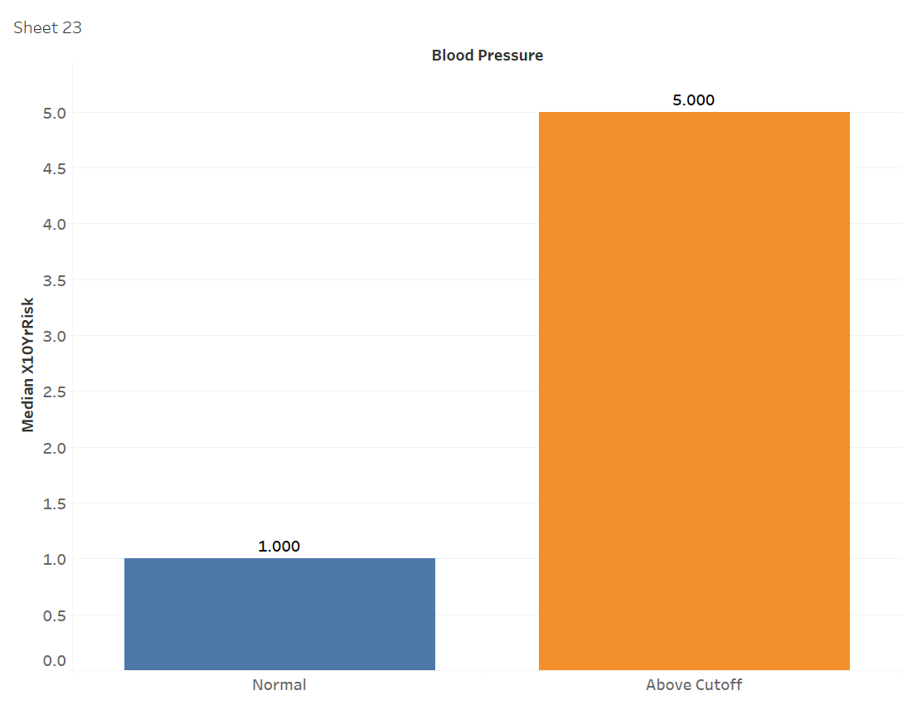
High cholesterol and blood pressure correlates with significantly higher risk of heart disease in the next 10 years
Cholesterol
Blood Pressure
Those with poor high cholesterol have a 4x higher median health risk
Those with poor high blood pressure have a 5x higher median health risk
Notes:
Looking at high cholesterol, those with high cholesterol have a 4x higher median 10 year health risk score than those without. This means that they are at a significantly higher risk of heart disease within the next 10 years.

Slide 24
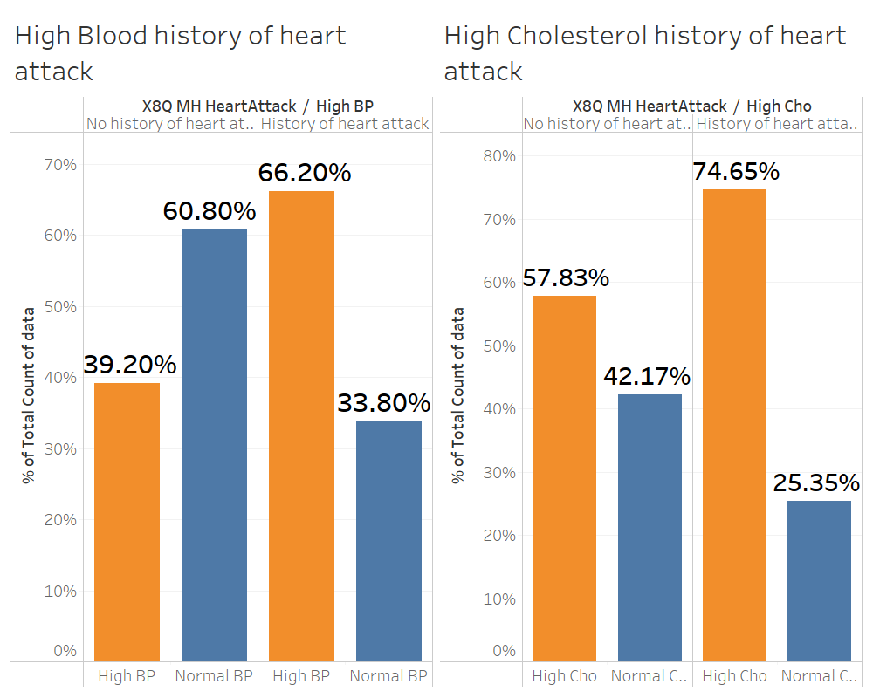
High cholesterol and blood pressure correlates with significantly higher risk of heart attack
Those with history of heart attack are 2x more likely to have had high blood pressure
Those with history of heart attack are 2x more likely to have had high blood pressure
Those with history of heart attack are 2x more likely to have had high blood pressure
Those with history of heart attack are 3x more likely to have had high cholesterol
Those with history of heart attack are 2x more likely to have had high blood pressure
Notes:
Looking at those with a history of heart attack, we can also see that there are 3x as many people who have high cholesterol.

Slide 25
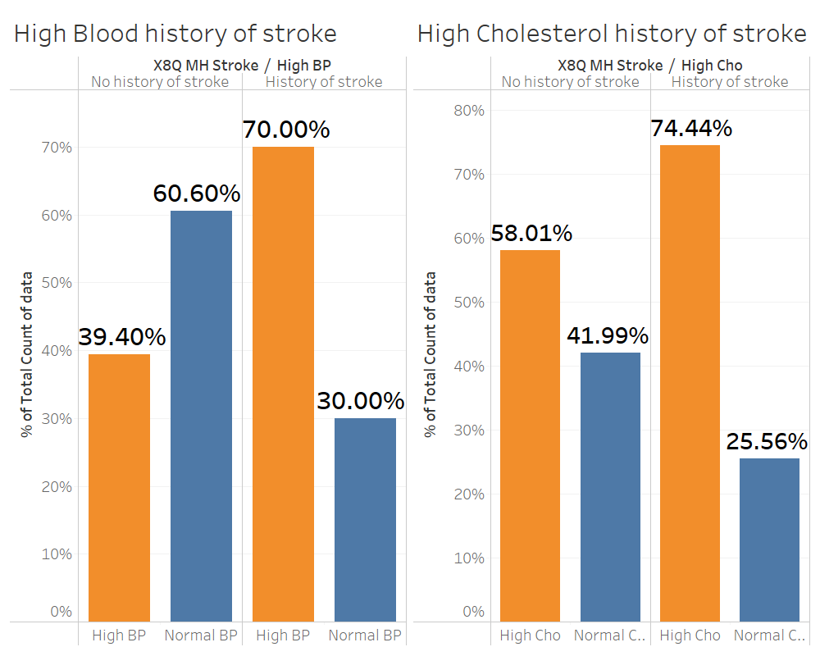
High cholesterol and blood pressure correlates with significantly higher risk of stroke
Those with history of stroke are 2x more likely to have had high blood pressure
Those with history of stroke are 3x more likely to have had high cholesterol
Notes:
Similarly for Stroke, there are 3x as many people who have high cholesterol than those with normal cholesterol.

Slide 26
High blood pressure & high cholesterol are the main underlying conditions plaguing our population.
High blood pressure and high cholesterol seem to be the main underlying health problems that are plaguing this ageing population due to how widespread and poorly controlled they are.
Despite having no early warning signs, they are highly correlated to stroke, heart disease and attacks. Hence, these are silent killers which necessitate more health screenings.
Notes:
Evidently, high cholesterol and high blood pressure are 2 very serious illnesses with very serious impacts. They seem to be the 2 underlying health problems that are plaguing our ageing population, and they are both diseases of the cardiovascular system. Furthermore, without any early warning signs, they are both silent killers, and this further proves how critical health screenings are.

Slide 27
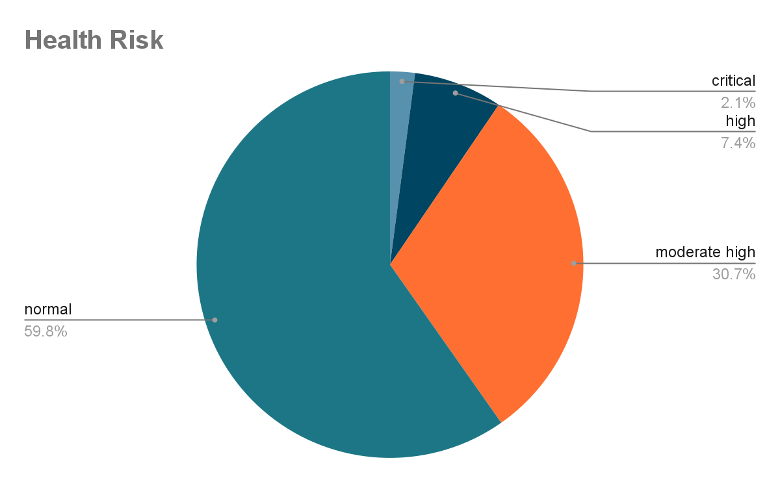
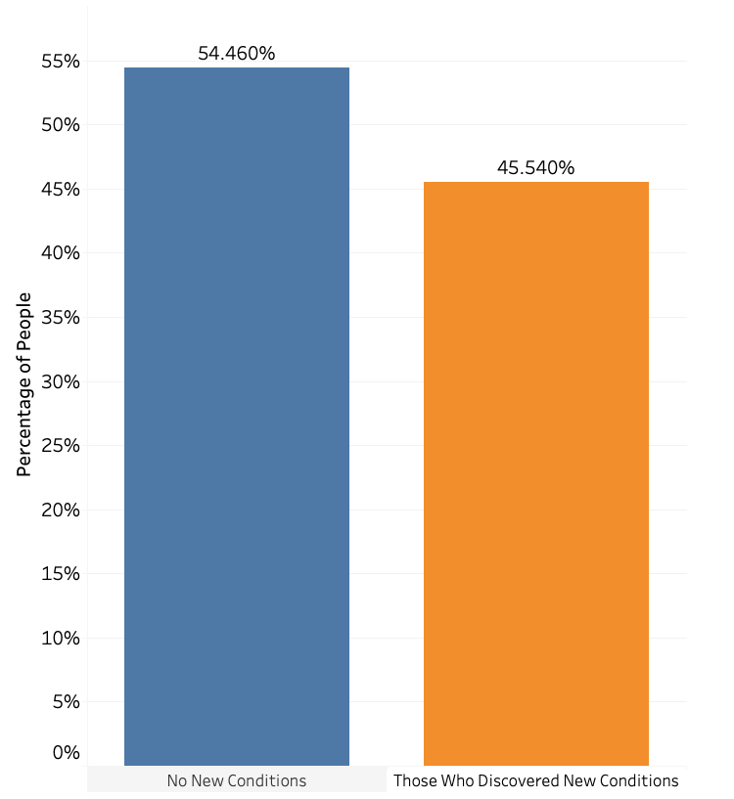
There is an imperative need to go for regular screening due to worrying statistics
Close to 1 in 2 participants discover new health condition upon screening
40% of participants have health risk moderately high and above
Notes:
From our analysis of data, we found compelling statistics to display and reasons to encourage the participation of regular screenings.
Firstly, close to 1 in 2 participants actually discover a new health condition upon screening. Since poor control of conditions is correlated with greater health risk as shown earlier, residents should attend screenings to detect any possible conditions so that they can properly control any them to minimise risks to their health.
Also, 40% of participants have health risk which is moderately high and above, therefore they are recommended to have their health monitored regularly.

Slide 28
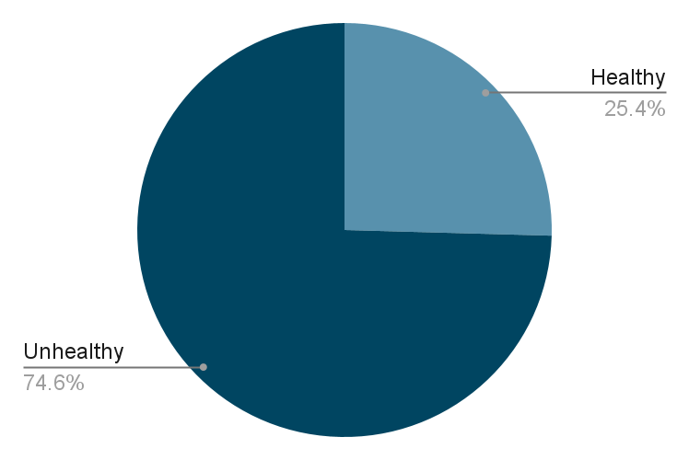
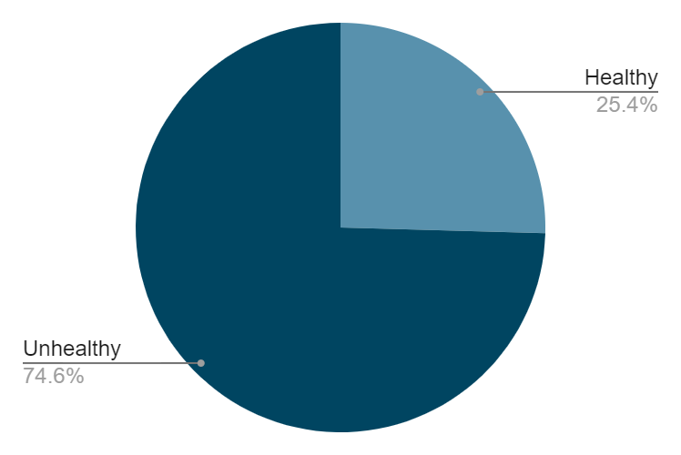
There is an imperative need to go for regular health screenings due to the stark differences in how people feel compared to their actual health
.
Out of those who feel that they have good health, ¾ are unhealthy
Out of those who did not follow up, 92% feel that they have good health
Notes:
Further analysis reveals that out of people who did not follow up, 92% feel that they have good health. Shockingly, ¾ of these people who feel that they have good health are actually classified as unhealthy. Therefore, it is necessary that we inform them that they should not be following up based on how they feel, since this is highly inaccurate. Rather, they should be attending regular screenings.

Slide 29
Summary
High blood pressure and high cholesterol are our biggest health problems
Many have medical conditions and poor control
Negative lifestyle habits
Poor population health
Notes:
Our analysis thus far has led us to observe that the population has a poor health profile, which is strongly associated with their negative lifestyle habits. We also found that many have medical conditions and exercise poor control of them. Upon further analysis of the medical conditions, we identified high blood pressure and high cholesterol to be the residents’ biggest health problems. Hence, with these findings, I will talk about targeted solutions.

Slide 30
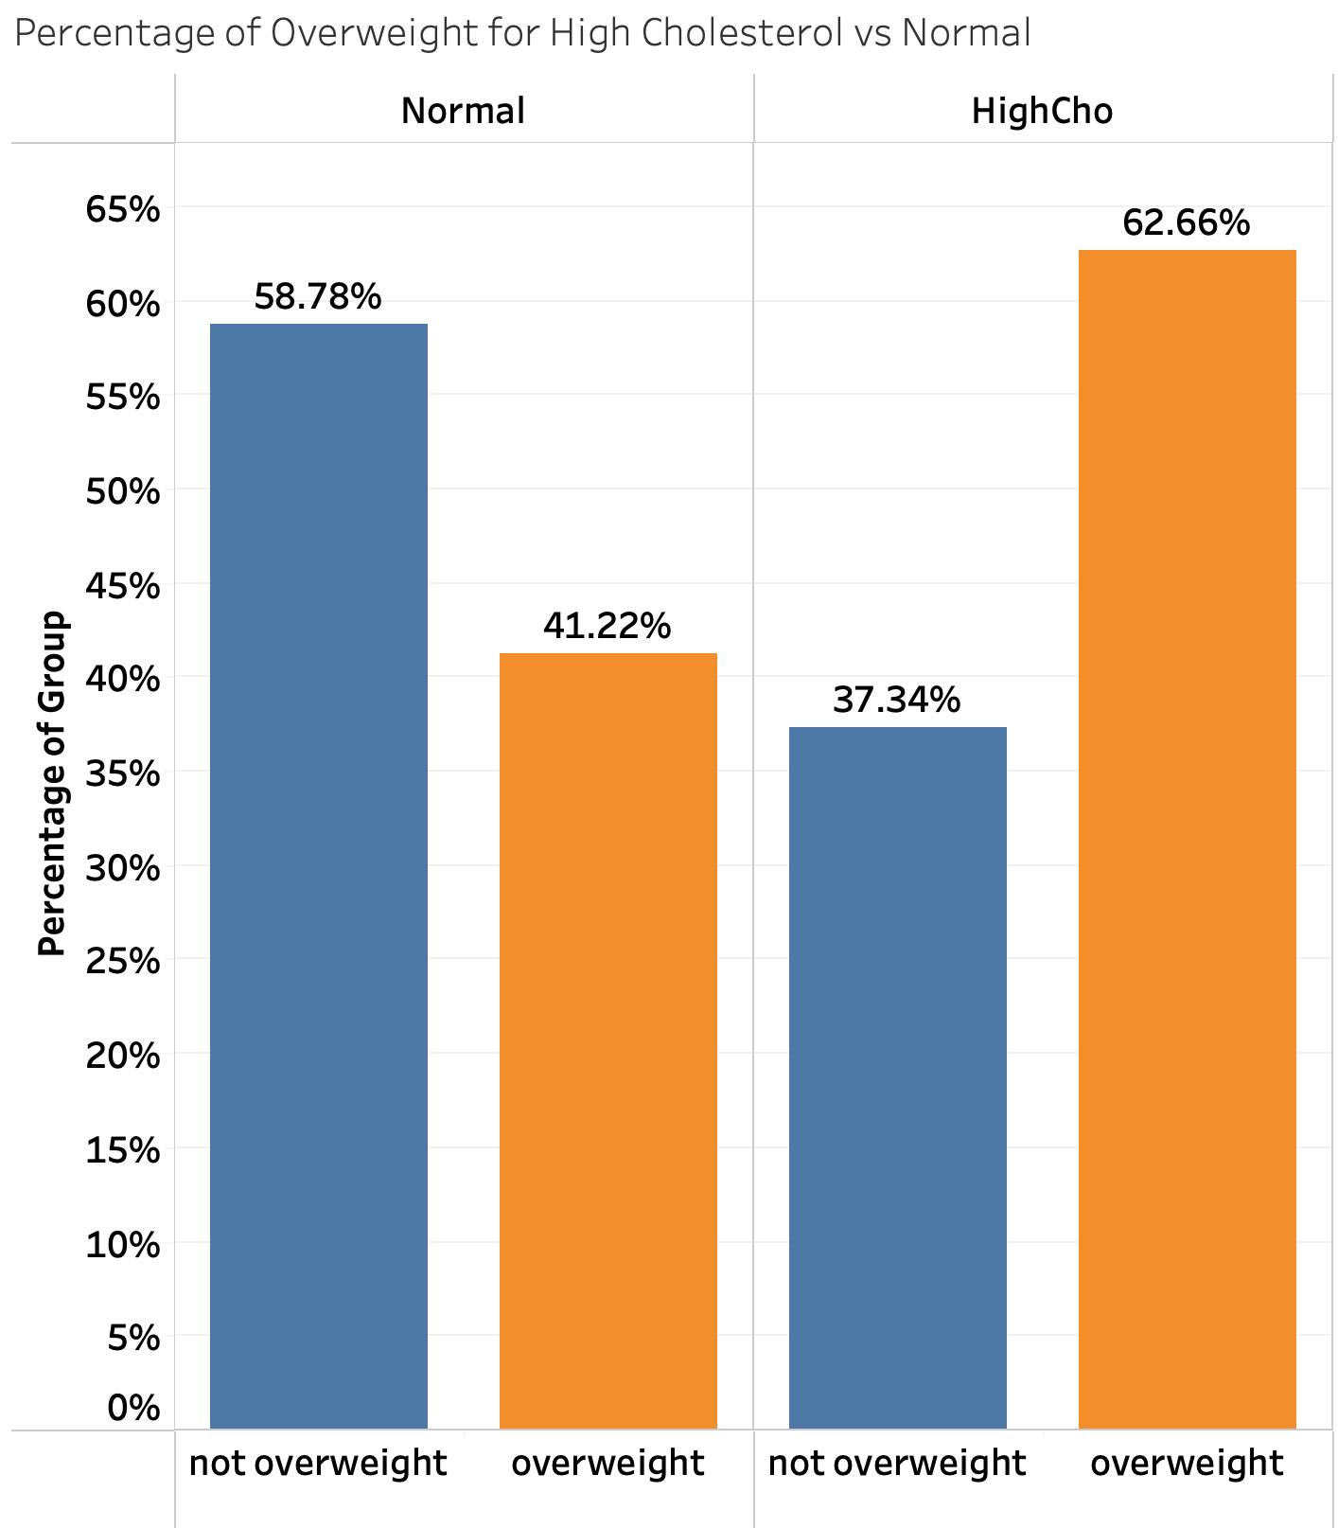
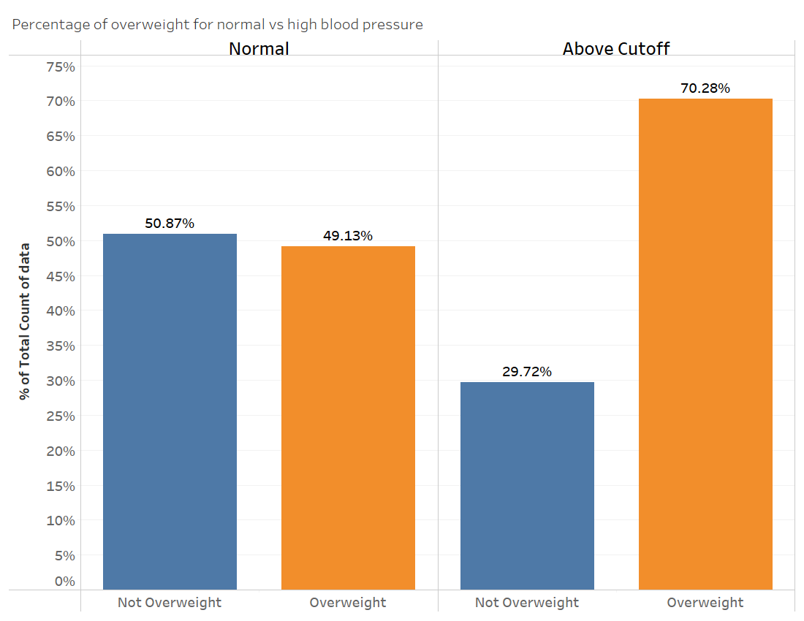
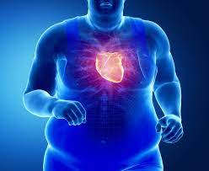
Uncovering possible underlying factors - overweight
Higher proportion of overweight people in those who have high cholesterol
Higher proportion of overweight people in those who have high blood pressure
In order to deal with the issue of overweight, we can work on improving exercise and diets habits since these are what the participants have issues with, especially since diet is highly correlated with health.
Notes:
While trying to uncover factors that could have possibly contributed to the silent killers, we found that the proportion of overweight people is significantly higher in those who have these conditions. This can possibly point to being overweight as one of the main contributing factors towards such conditions, also since 58% of the analysed population is overweight.
Looking back at our habits analysis, we realised that participants have poor eating and exercise habits, which are possible reasons for the high proportion of overweight people and hence the rise of the silent killers. Thus, we can aim to improve on them, especially since diet is highly correlated with health.

Slide 31




Multi-pronged strategy to tackle overweight by utilising HPB’s app
MULTI-PRONGED STRATEGY
Raising awareness about healthier habits
Promote these ideas through campaigns like HPB’s Eat, Drink Shop Healthy campaign
Increase advertisements exposure
Incentivising to adopt healthier habits
Rewards through HPB Healthy 365 App
Introduce smart watches to better understand their health data over time and incentivise residents to take charge of their health.
Possible Alternative:
Tailor screenings to focus on most important conditions
Notes:
Moving forward to effectively improve on the population’s eating and exercise habits and reduce the occurrence of being overweight, we have decided to propose a multi-pronged strategy to raise awareness of the need for healthier habits and incentivise residents to take part in such events.
For example, we can promote such ideas through HPB’s existing Eat, Drink Shop Healthy Campaign at screening events and introduce the Healthy 365 app which complements the campaign. Increased advertisements exposure can also raise awareness about the dangers and widespread occurrence of high blood pressure and cholesterol.
To incentivise people to adopt healthier habits, participants will be rewarded through the app upon the purchase of healthier choice options. We can also look to introduce fitbits to those who regularly come for screening events and connect them to the app. This allows them to better track their exercise and take control of their physical health. Moreover, the fitbit will provide real-time data and measures of their health unlike screening events which are only accurate at the current time.
One possible alternative is to tailor future screening events to focus on detecting the most important conditions so that we can reach out to a wider population. Through this, we can further investigate the impact of the silent killers on our population and mitigate their effects as efficiently and effectively as possible.

Slide 32



Conclusion
Healthier
Habits
Better Well-Being
Condition Control
Achieve Aim
Better exercise and diet
Improved health and lower occurrence of being overweight
Reduced severity and occurrence of high cholesterol and blood pressure
Reduced strain on healthcare systems and fatalities
Notes:
Through our strategy, we hope to improve resident’s dietary and exercise habits which can in turn lead to better health and lower occurrence of being overweight. This can reduce the severity and occurrence of the silent killers to minimise the strain on healthcare systems and fatalities, especially during this period with an ongoing pandemic where resources are heavily strained.
Thank you for listening to our presentation! My team and I hope to have provided key insights for you to aid in your decision-making in planning screenings and improving health of singaporeans moving forward.

